Slide 1
BASIC PRESENTATION
By keith

Slide 2
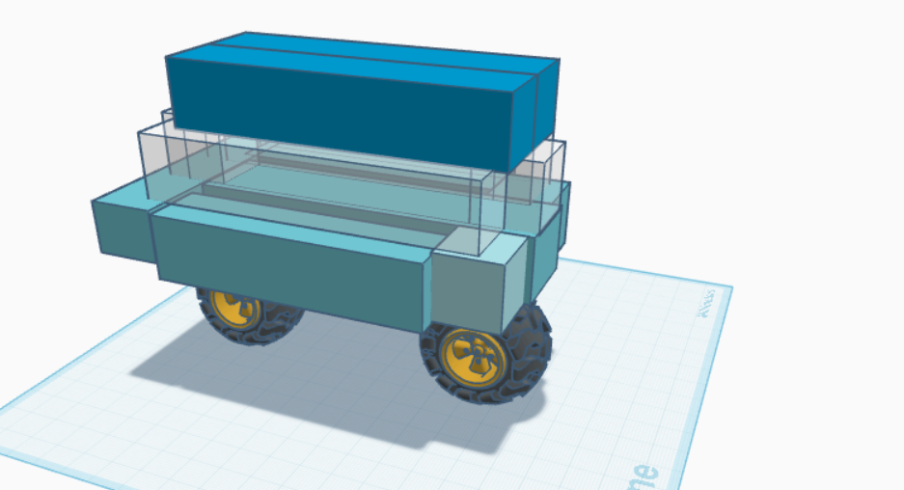

Slide 3
Delivering with confidence
The car I made was kind of hard. It is a car the you can buy it for 45000.

Slide 4
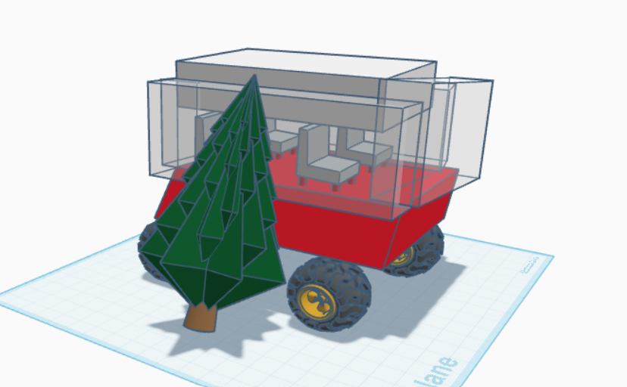

Slide 5
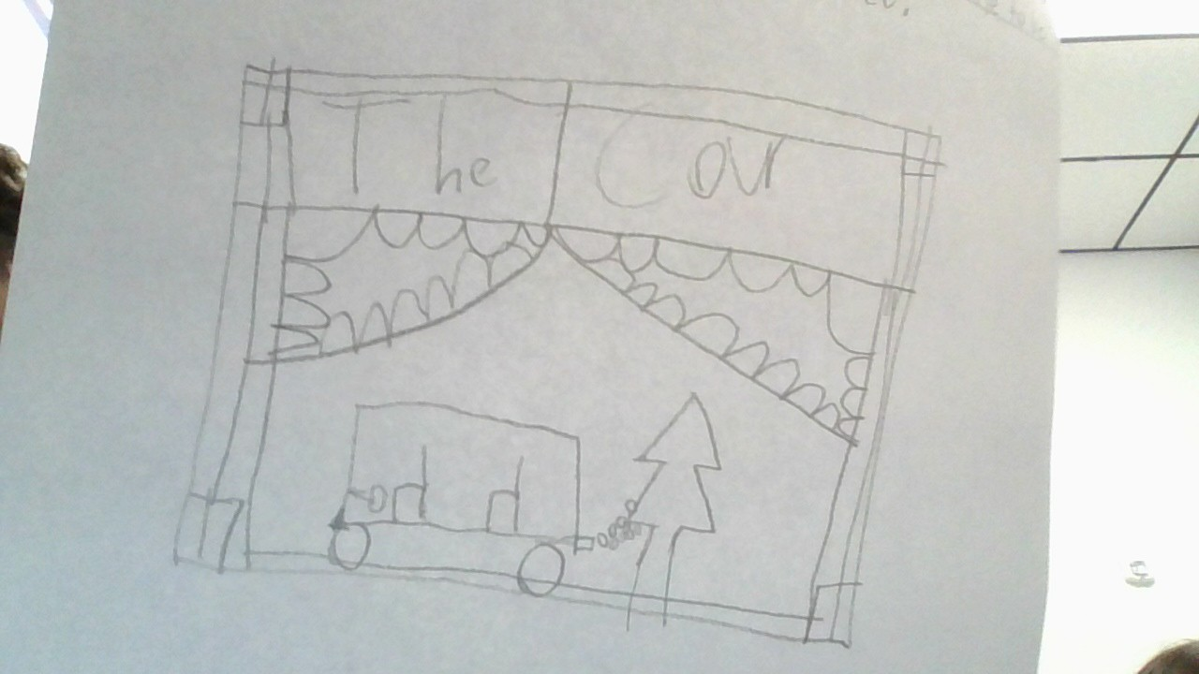
MY car I made was kind of like a cyber truck . The tree I bent it because there was a car carshed into the tree it was made with 4weehls and ai at of blocks . I you want to build it first you get 4 wheels on tinerad then you get one block and place it on the wheels and then you get 4 blocks and put it around the blocks you put on the wheels next you get another block and place it on the roof last you add the tree and bend it a little to be more creatived.Add chairs inside.

